Slide 1

Conference Issues Briefing
April 18, 2013

Slide 2


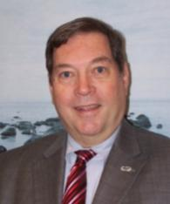


On Today’s Webinar
Bryan Welsh
Webinar Moderator &
Director of Membership
Nicole Vasilaros
Director, Regulatory and Legal Affairs
Jim Currie
Legislative Director
Jeff Gabriel
Legislative Counsel

Slide 3
On Today’s Webinar
Introduction
Boating Access
Dredging
Ethanol
Second Home Interest Deduction
Hill Visits 101
Q & A
Notes:
Those who are veteran attendees and do not need to hear Hill Visits 101 can drop off the call before the final section.

Slide 4
Conference Materials
Download policy briefs and talking points online at:
http://www.nmma.org/government/abc
Hard copies of these documents will be available at registration. You will receive a copy to keep as well as extra copies to leave behind at your Hill visits.

Slide 5
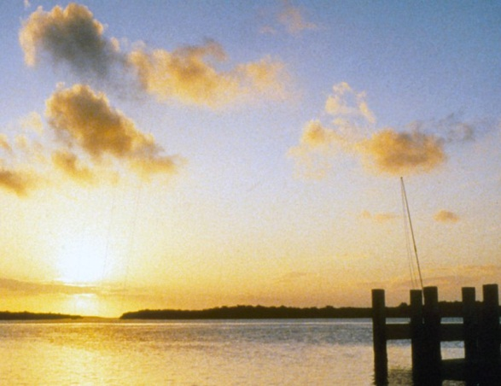
Recreational Boating Access
  PRESENTED BY
  Nicole Vasilaros
  Director of Regulatory and Legal Affairs

Slide 6
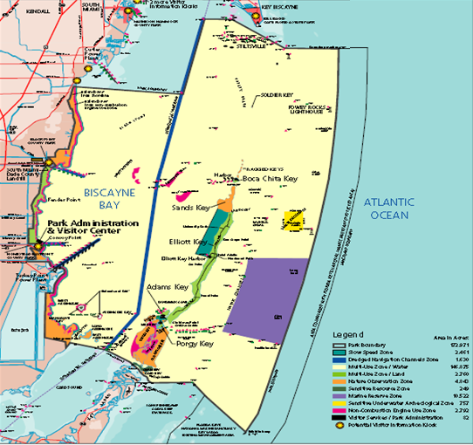
Biscayne National Park
  Background: In August 2011 the National Park Service published a draft General Management Plan (GMP) which proposed to close 10,000 acres of the Park’s waters to fishing by establishing a “marine reserve” and create a non-combustion engine zone along the entire coastline
  Update: The Florida Fish and Wildlife Conservation Commission (FWC) and NPS, since Fall 2012, have been meeting regularly to renegotiate the “marine reserve” for the final GMP

Slide 7
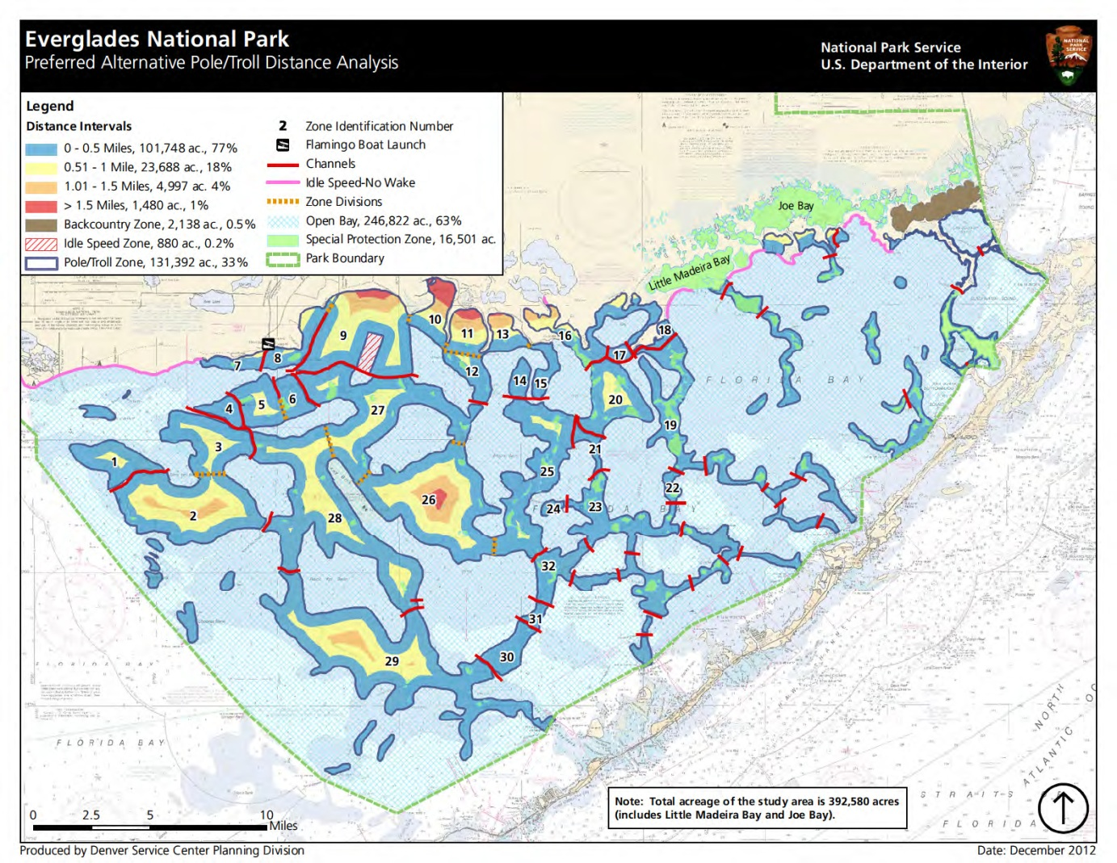
Everglades National Park
Background: National Park Service published a propose GMP in March 2013

Slide 8
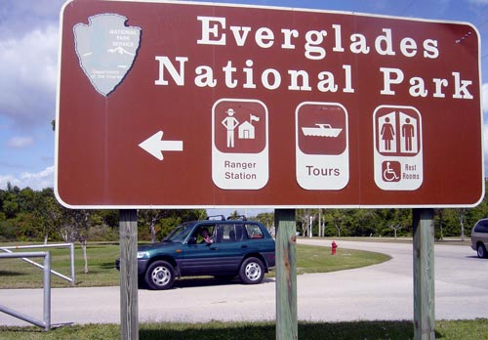
Everglades General Management Plan
Key Issues:
  131,000 acres of Park waters would be turned into Pole and Troll zones
  Boaters would be required to take a special online boater education course to operate within Park waters
  Navigational markings and outreach to implement these proposed Pole and Troll Zones and Educational requirements lack proper attention and necessary funding

Slide 9
Everglades General Management Plan
Suggested Alternatives:
  Minimize overall Pole and Troll Zones.
  Where Pole and Troll is appropriate, necessary channels must be drawn to allow motorized access to feasibly navigate.
  Eliminate separate boater education requirement. NMMA supports boater education, but believes it should be implemented on a state level, not waterway specific. Instead, invest resources into educational outreach.
  Increase channel and other navigational markings to better aid boaters and fisherman.

Slide 10
Ask Your Legislator
There is a startling trend with the National Park Service and National Marine Sanctuary System where boating access is being denied and/or restricted
Robust access to public waters and lands must be maintained
Decisions to restrict public access should be balanced and include:
  Rigorous scientific study
  Access restrictions imposed for the least required amount of time and with measurable benchmarks for review
  Consideration of economic impact
  Input from local stakeholders and state agencies

Slide 11
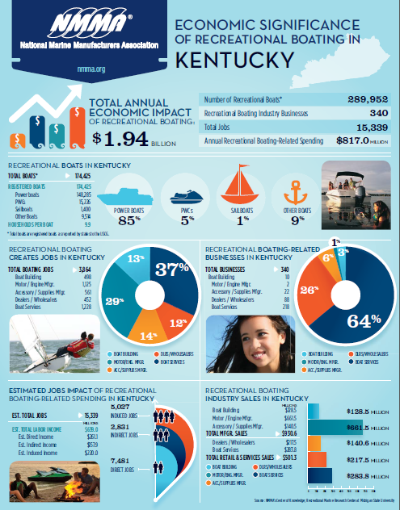
Economics of Recreational Boating in the United States
NMMA along with the Recreational Research Center at Michigan State University conducted a study in 2012 of the Economic Significance of Recreational Boating in the US
Information will be available on a state and Congressional district level
Economic Data Sheets will be distributed at ABC and available for electronic circulation to NMMA members

Slide 12
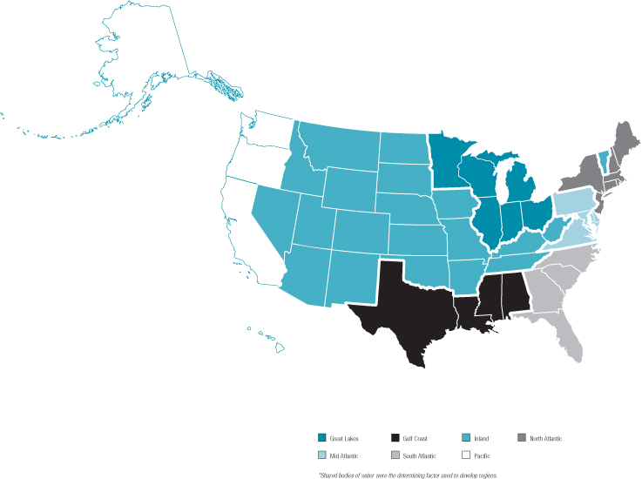
Economic Impact of Recreational Boating Preview….
Total Economic Impact: $121.5 Billion annually
12 million registered boats
963,818 Recreational Boating Jobs
34,833 Recreational Boating Businesses

Slide 13
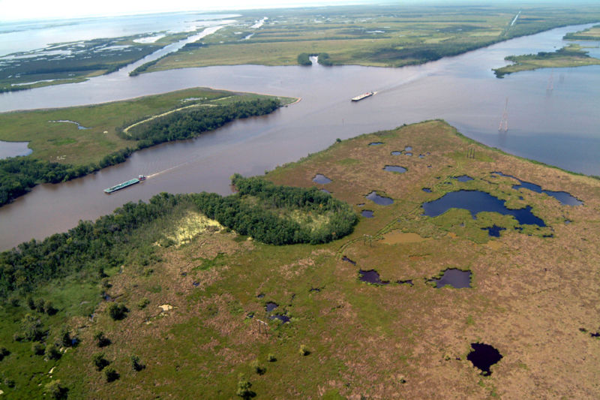
Dredging Needs at Critical Stage
Water Resources Development Act
Long-overdue legislation that authorizes Army Corps water resource projects throughout the nation, including the critical dredging projects throughout the U.S.
WRDA provides money to build boating access points.
S. 601, the Water Resources Development Act was passed unanimously out of the Senate Environment and Public Works Committee. The House presently is drafting its version of WRDA.
NMMA Position: Support

Slide 14

Dredging Needs at Critical Stage
Army Corps Funding for Navigational Dredging
NMMA is working to increase Army Corps funding for navigational dredging projects.
Congress must amend the statutory language of the Harbor Maintenance Trust Fund to ensure that “surplus” dollars in the Fund are spent for critical dredging projects across the country.
Low depth levels pose safety hazard for boaters and slow commerce.

Slide 15

Ethanol
  PRESENTED BY
  Jim Currie
  Legislative Director

Slide 16
Why E15 Ethanol is Bad for Boats
  Marine and many other engines are not designed, calibrated, certified, or warranted to run on E15
    Tests conducted by NMMA members have demonstrated that E15 can cause severe engine damage;
    E15 also causes performance issues such as starting problems, stalling, and fuel vapor lock;
    E15 leads to increased water absorption and phase separation of gasoline and water while in the tank;
    E15 causes increased emissions of smog-forming pollutants such as NOx, because the ignition of E15 creates a higher combustion temperature than does straight gasoline or E10.

Slide 17
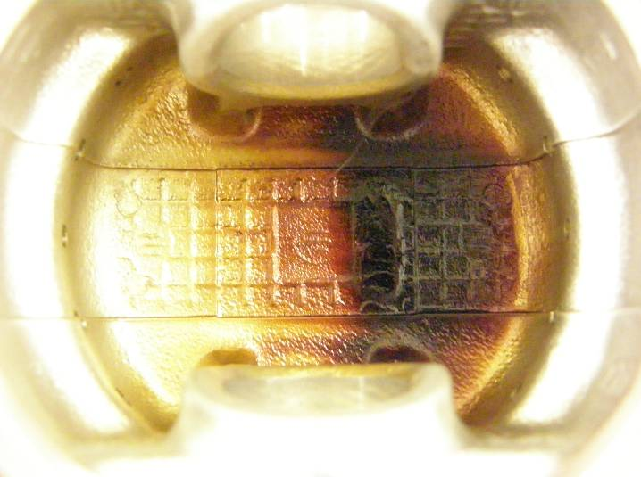
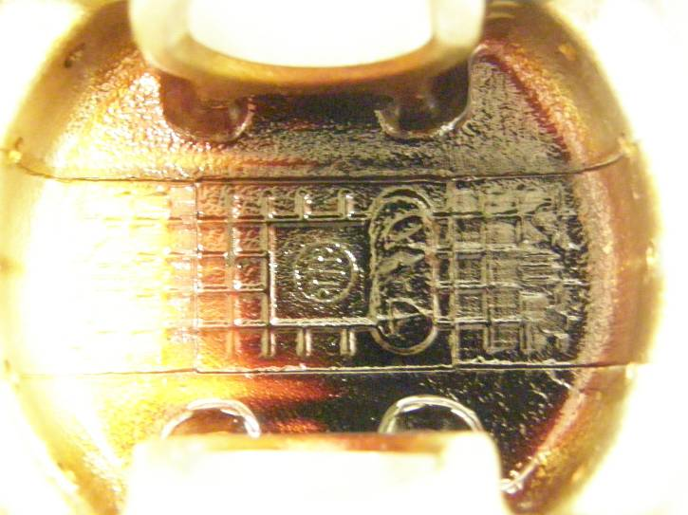
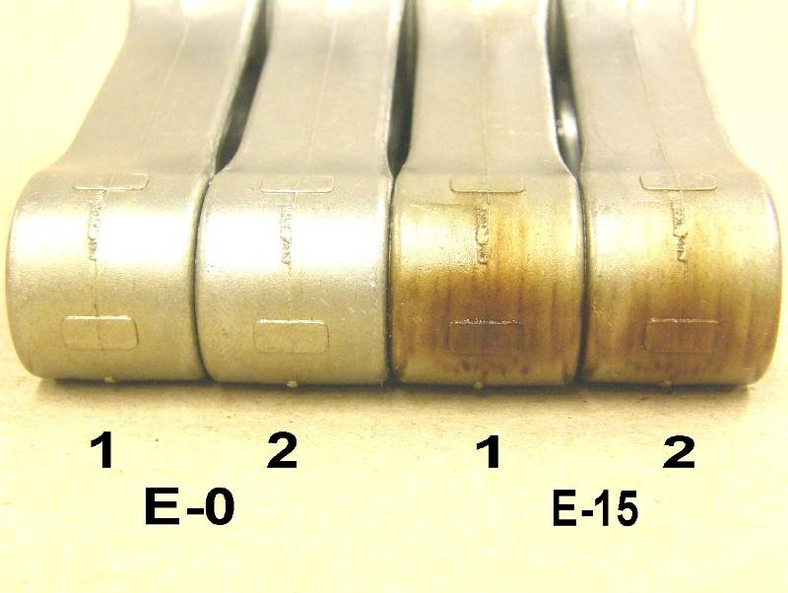
9.9HP Carbureted 4-Stroke
More carbon deposits on piston underside and rods of E15 engine.
E0
E15

Slide 18
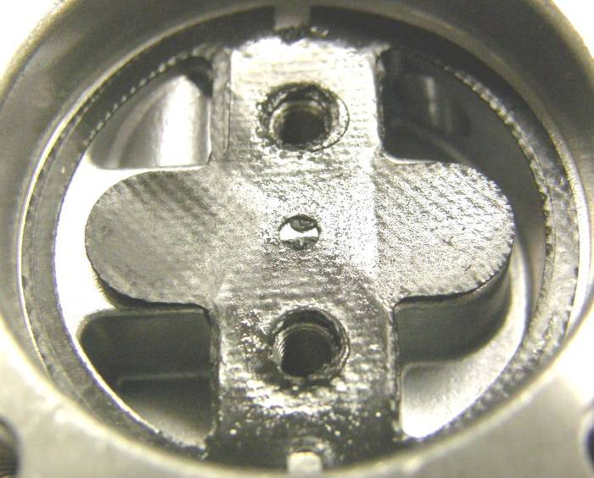
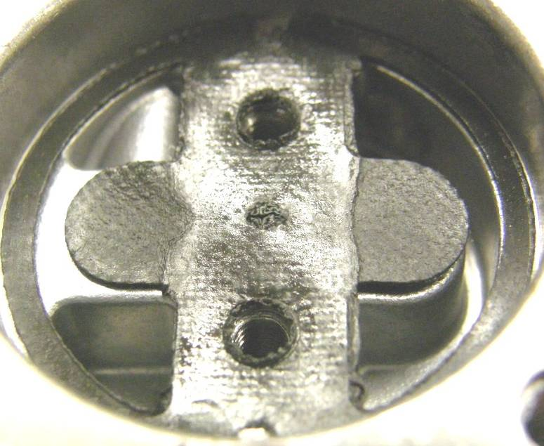
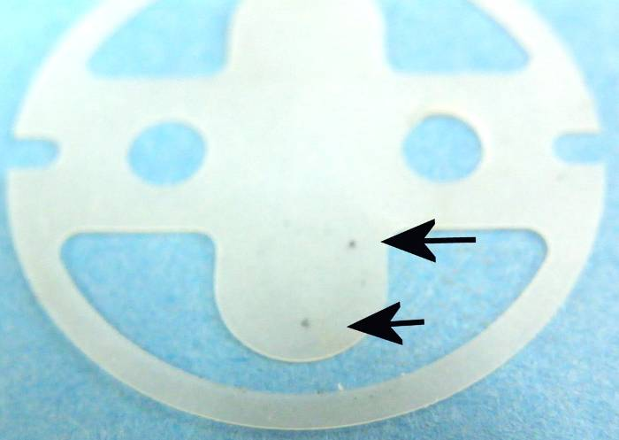
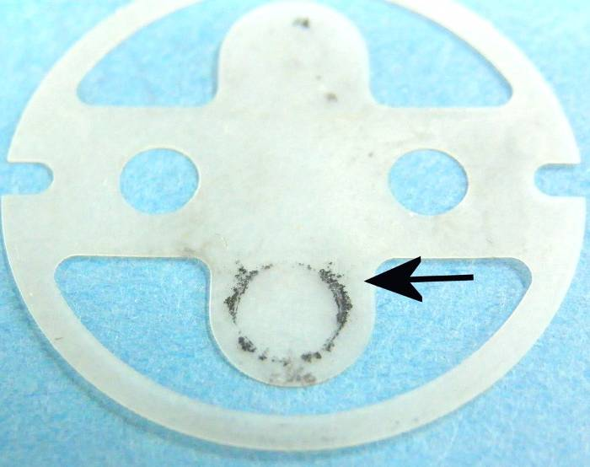
9.9HP Carbureted 4-Stroke
The fuel pump gasket showed signs of deterioration on the E15 engine compared with the E0 (pure gasoline) engine.
E0
E15
Material transfer from gasket to check valve in fuel pump.

Slide 19
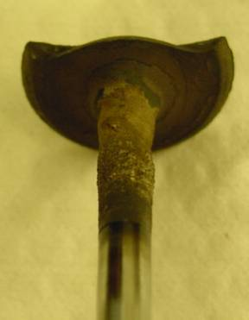
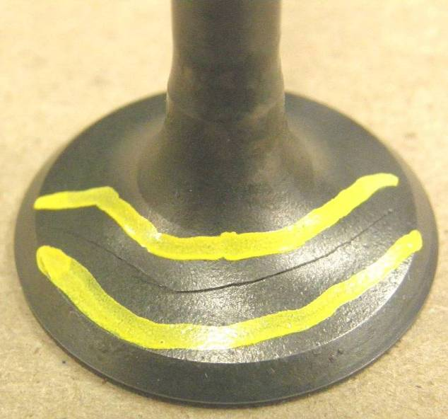
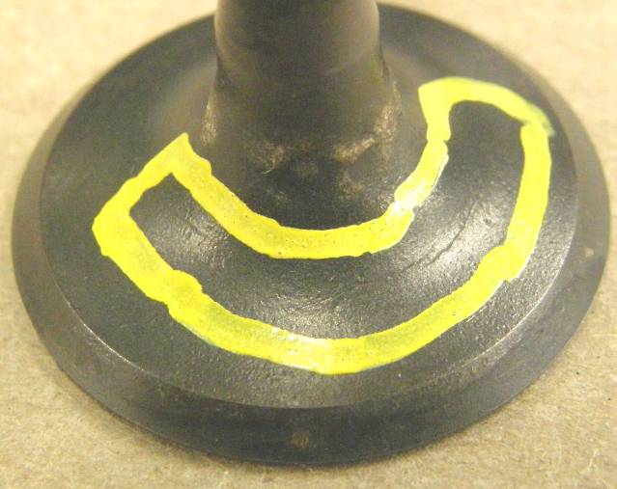
300HP Supercharged 4-Stroke
Cylinder 3
Bottom Valve
Cylinder 3
Top Valve
Cylinder 6
Top Valve

Slide 20
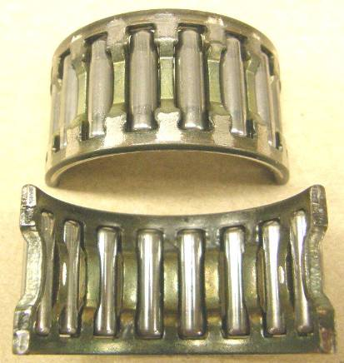
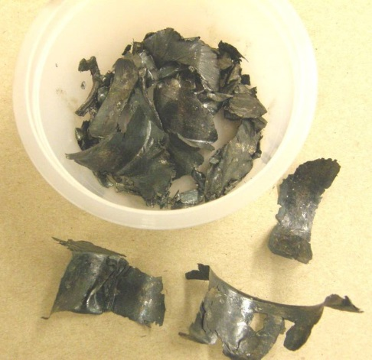
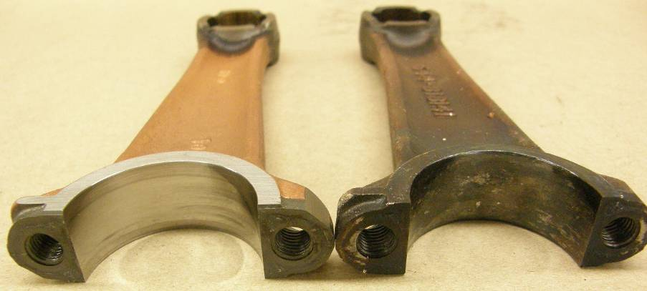
200HP EFI 2.5L 2-Stroke
Undamaged Bearing
Recovered Pieces from Failed Rod Bearing
Undamaged Rod Damaged Rod

Slide 21
Ethanol
Ask Your Legislator
  To support legislative efforts to require further study of E15’s effects on engines before it can be allowed in the marketplace (HR 875, Rep. Sensenbrenner)
  To support efforts to cap the amount of ethanol in gasoline at the 10% level (S. 344, Wicker and Vitter and HR 1462, Goodlatte, Costa, Womack, Welch, and others)
  To oppose legislative efforts that make it easier for E15 to reach the market, such as by removing liability from retailers
  To oppose any efforts to approve E15 for small engine and marine applications

Slide 22
For more information, visit www.smarterfuelfuture.org

Slide 23
Deduction for Interest Payments on Boats
The Issue
  The IRS Code allows taxpayers to deduct the interest payments on their boat, providing they and the boat meet certain requirements:
    You can only deduct payments on two dwellings (primary and one secondary, whether land-based, an RV, or a boat)
    The total amount on which you can deduct interest payments is capped at $1.1 million
    The boat must have a head, a galley, and a sleeping berth to qualify for the deduction

Slide 24
Deduction for Interest Payments on Boats
The Controversy
  Certain members of Congress have claimed that this deduction is a “taxpayer subsidy for rich yacht owners” and want to eliminate it
    The median household income for boat owners is between $50K and $75K
    Consumer boat loans average $48,900, with 83% of those borrowing earning less than $250,000
    The wealthy who own large yachts do not qualify for or take the deduction

Slide 25
Deduction for Interest Payments on Boats
The Solution
  Tell your members of Congress that eliminating the deduction hurts middle income Americans – not the super rich
  Tell your members of Congress that boat owners should not be discriminated against just because their second home floats

Slide 26

Q & A
  MODERATED BY
  Bryan Welsh
Notes:
26

Slide 27
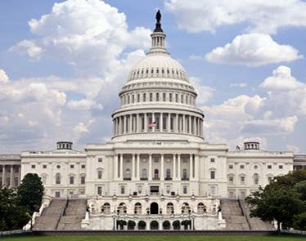
Hill Visits 101
  PRESENTED BY
  Jim Currie
  Legislative Director

Slide 28
Hill Visits 101
Before you head to the Hill:
  Dress appropriately: business attire and walking shoes;
  Caution: Be sure not to take anything with you that could be construed as a weapon (e.g., pocket knife, pepper spray);
  You will receive your Hill schedule at the start of the conference when you register at ABC;
  Determine whether your Members of Congress are in the Congressional Boating Caucus. The Caucus Membership list is in your packet and the leave-behind materials;
  Keep an eye on your cell phone while in DC – if there are any last-minute changes, you will hear from NMMA staffer Laura Genovese.
Notes:
Congressional schedules often change last-minute or are not finalized until the week before – this is why we can’t send your Hill schedule ahead of time.

Slide 29
Hill Visits 101
Heading to Capitol Hill:
  Allow plenty of time to go through security and find the office(s) you will visit;
  Bring business cards and your issues briefs to leave behind;
Notes:
We have done our best to provide everyone who requested an NMMA staff person with someone to escort them, but please understand that because of the timing of the Hill visits, one may not be available.

Slide 30
Hill Visits 101
During Your Visit
  Be flexible: Because of the constant changes in Congressional activities, you may be asked to wait, meet with another staffer, or meet in another location.
  Tell the legislator or staffer:
    What your business contributes to our economy and how many people you employ; give them one of the State and Congressional district sheets showing economic impact of recreational boating.
    About your legislative issues (issue briefs).
  At the end of your meeting:
    Thank the Member of Congress and/or staffer for their time and support;
    Ask them to join the Congressional Boating Caucus, if they are not a member; you will have a list of current members in your packet
    Invite them to the Congressional Boating Caucus Reception in the Rayburn Foyer from 5:00 to 6:00 pm that afternoon;
    Invite them to tour your facility during the August recess.

Slide 31
Hill Visits 101
After Your Hill visit:
  Follow up with a thank-you email
  Include any additional information they requested, a brief overview of your “ask” on the issues you discussed, and a reminder that you will follow up later in the summer about an August facility tour
  In July, follow up with another email inviting your Member of Congress and their staff on a facility tour
  Contact NMMA if you need help organizing a Congressional visit

Slide 32
Congress 101
Understanding Congress and the Legislative Process
  Congress is a political body, and the men and women who serve there are politicians.

Slide 33
Congress 101
Understanding Congress and the Legislative Process
  The Majority runs the House of Representatives.

Slide 34
Congress 101
Understanding Congress and the Legislative Process
  The Minority has a great deal of power in the Senate

Slide 35
Congress 101
Understanding Congress and the Legislative Process
  Campaigns cost too much—and fundraising never stops.

Slide 36
Congress 101
Understanding Congress and the Legislative Process
  Members of Congress attempt to give us what they think we want

Slide 37
Congress 101
Understanding Congress and the Legislative Process
  We dislike the Congress, but we like our own member—sort of.

Slide 38
Congress 101
Understanding Congress and the Legislative Process
The Congress is a very frustrating place to work

Slide 39

Boating Caucus Reception
After your Hill visits, please join us and Members of Congress and their staffs at the Congressional Boating Caucus Reception!
5:00 – 7:00 PM
Rayburn Foyer

Slide 40

Thank you for participating in the 2013 American Boating Congress!

