Slide 1
2018 policy survey
WHAT ISSUES MATTER MOST

Slide 2

Issues that directly impact boaters matter most to the industry.
TOP FIVE ISSUES
1 Ethanol and Fuel
2 Recreational Fishing
3 Tax
4 Trade
5 Boating Safety

Slide 3
Issues that directly impact boaters matter most to the industry.
ADDITIONAL KEY ISSUES
- Workforce
- Conservation
- Other Separate Issues
- Infrastructure

Slide 4
Drill Down
Workforce
Conservation
Infrastructure
Trade
Other Separate Issues

Slide 5
Trade Issues Ranked
1 Support and Protect Trade Agreements
2 Retaliatory Tariffs
3 Reduce Non-tariff Barriers
4 Promote Harmonized Technical Standards Across Countries
5 Reduce Duplicative Product Certification

Slide 6
Workforce Issues Ranked
1 Work Ethic of Applicants
2 Unique Skills Required
3 Lack of Applicants
4 Inability to Pass a Drug/Background Screening
5 Compensation Expectations of Talent are Too High
6 Citizenship and Immigration Barriers

Slide 7
Conservation Issues Ranked
1 Aquatic Invasive Species
2 Red Tides and Harmful Algae Blooms
3 Boat Recycling and Derelict Vessels
4 Impact of Climate Change on Water Access
5 Everglades Restoration

Slide 8
Other Separate Issues Ranked
1 Right to Hunt and Fish Constitutional Amendments
2 Permitting
3 State Outdoor Recreation Offices
4 Dealer Contracts
5 Vessel Titling

Slide 9
Infrastructure Issues Ranked
1 Protect the Sport Fish Restoration and Boating Trust Fund
2 Increase Number and Condition of Boat Ramps
3 Dredging to Deepen and Maintain Access
4 User Conflict on Waterways
5 Anchorage Restrictions

Slide 10
56% of our audience is engaged

Slide 11
More likely to send letters or share posts

Slide 12
Email Me Directly

Slide 13
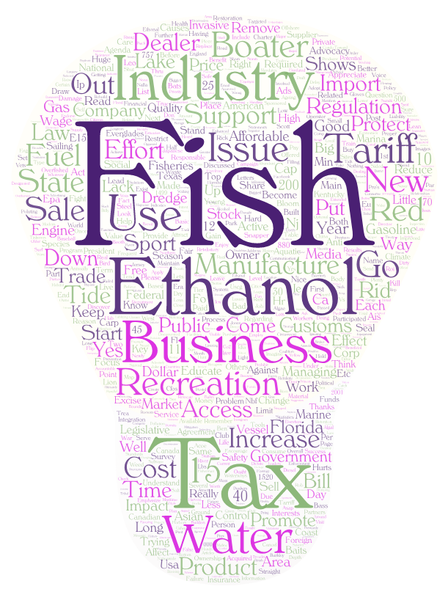
Open mic

